Slide 1
Final Project Examples
Bad / Good samples

Slide 2
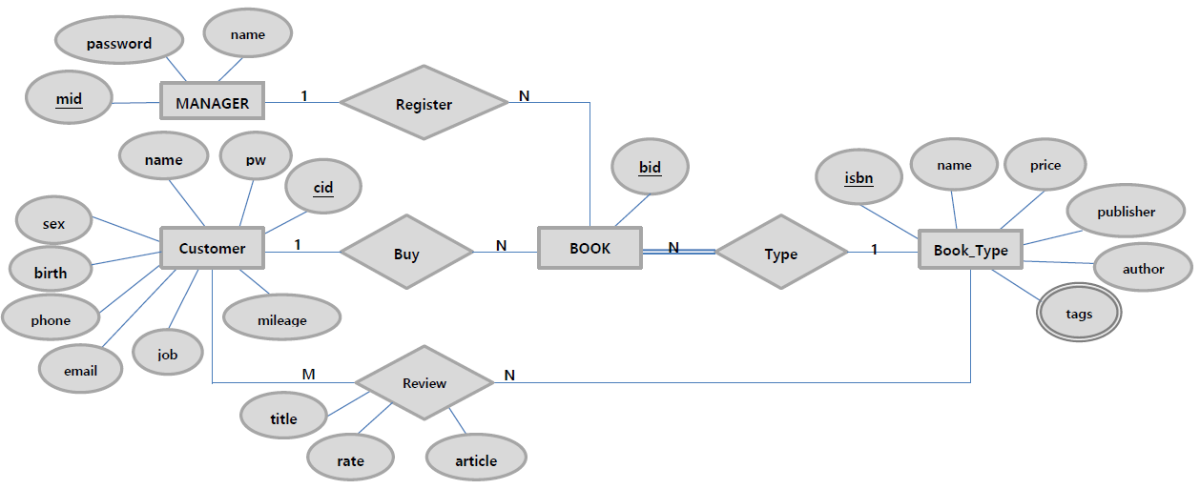
ER diagram :: Figure (Good Example)

Slide 3
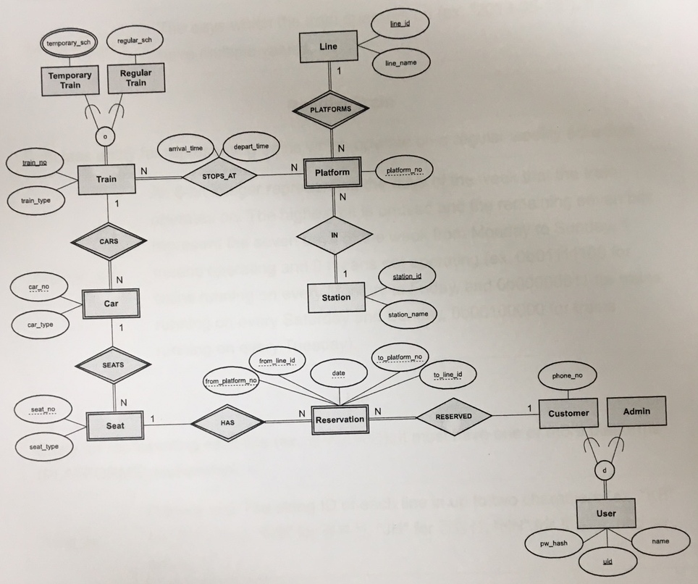
ER diagram :: Figure (Good Example)

Slide 4
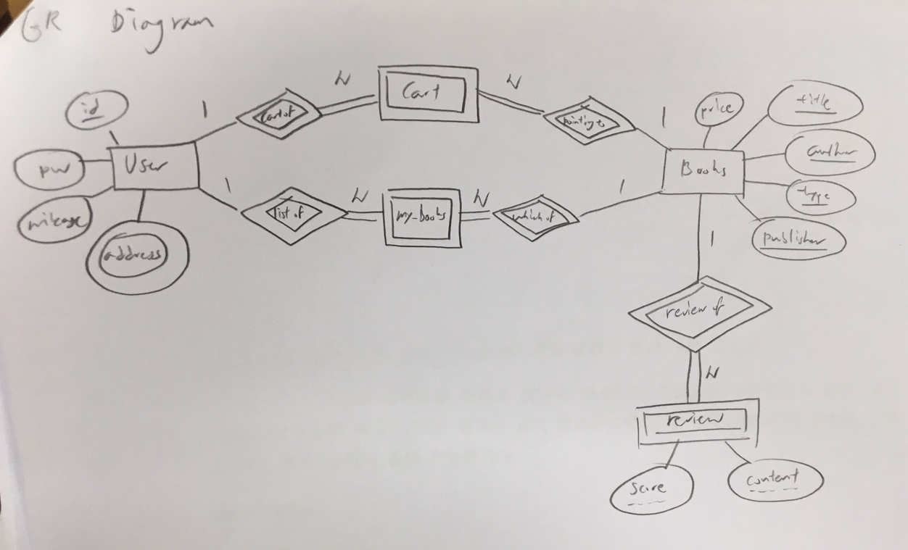
ER diagram :: Figure (Bad Example)
It is difficult to recognize the names

Slide 5
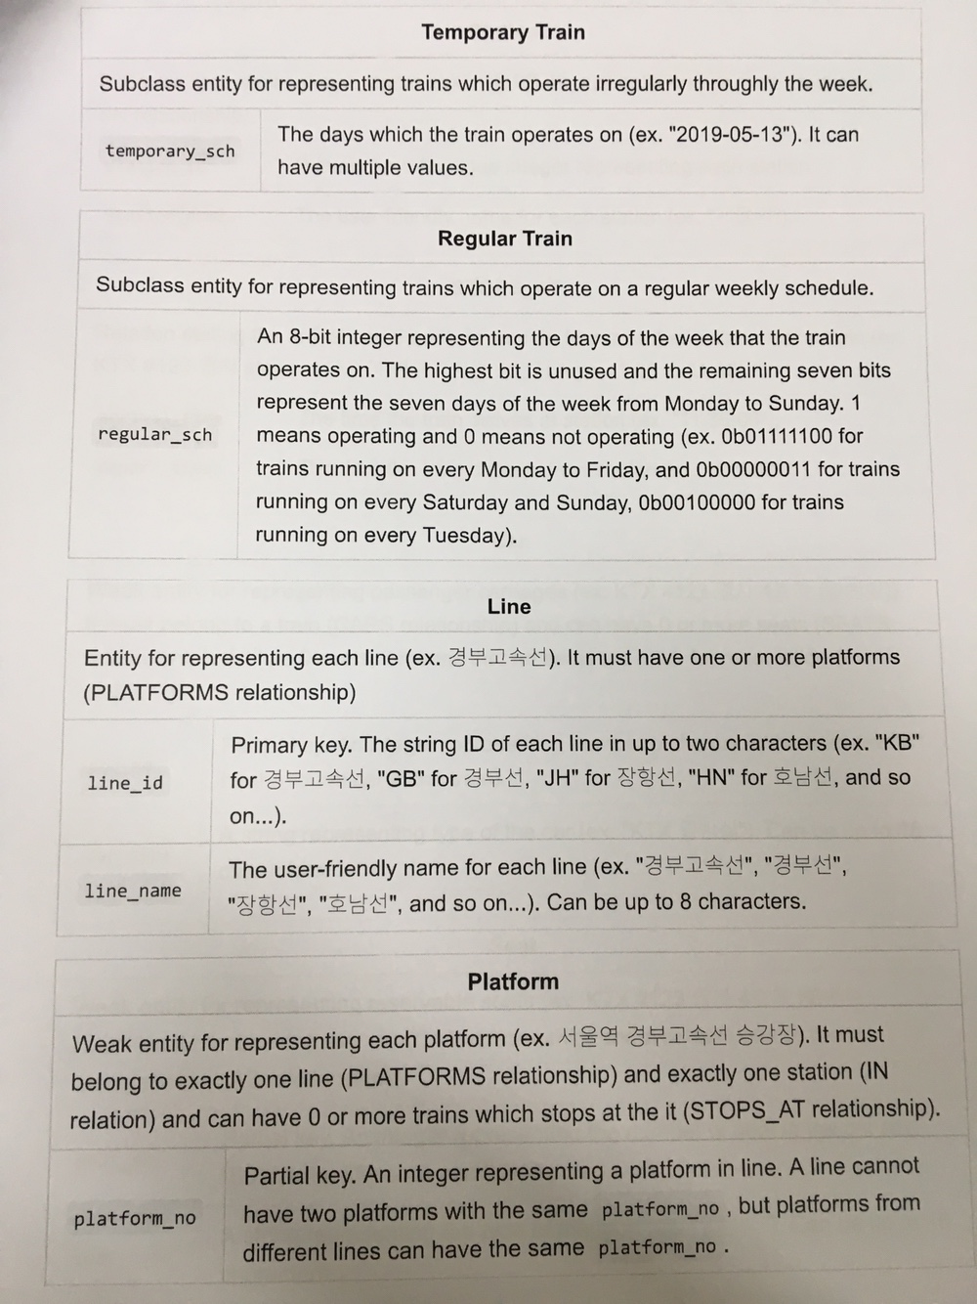
ER diagram :: Descriptions (Good Example)

Slide 6
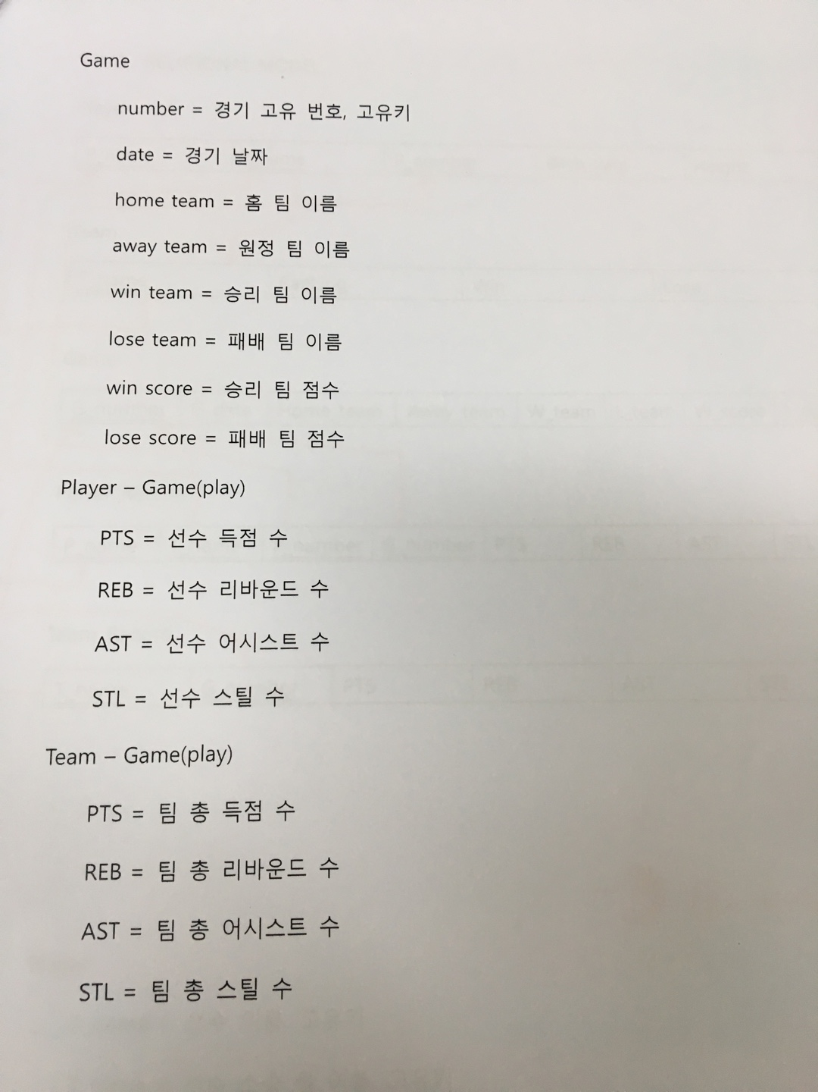
ER diagram :: Descriptions (Bad Example)
<Descriptions of Relation ‘play’>
<Descriptions of Entity ‘Game’>
This is not an explanation, just a translation…

Slide 7
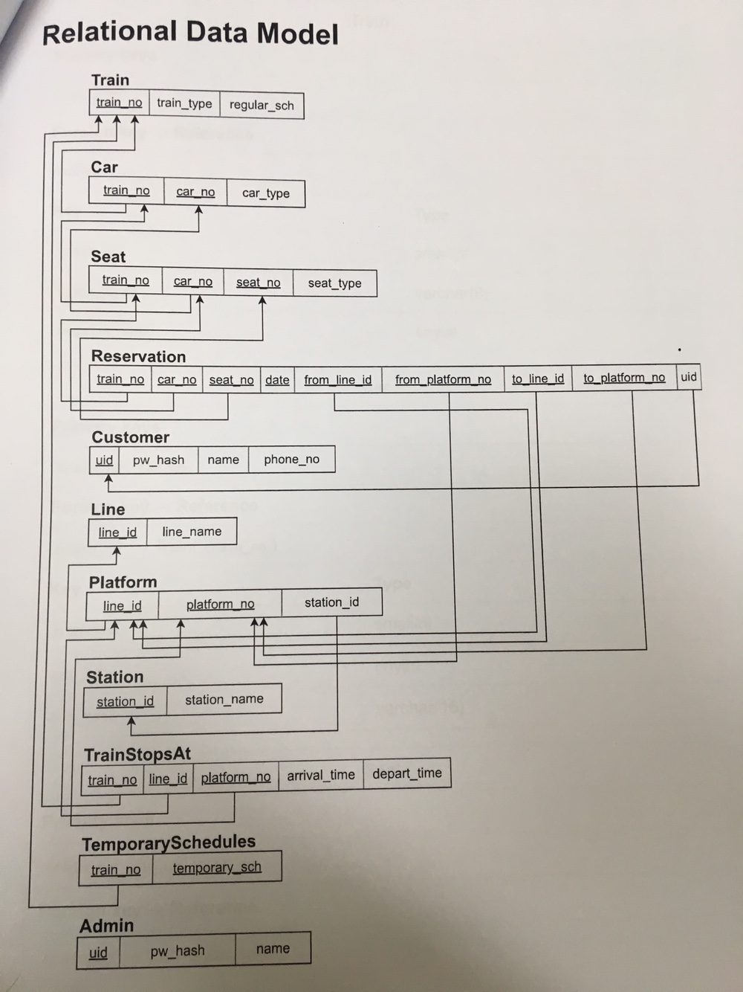
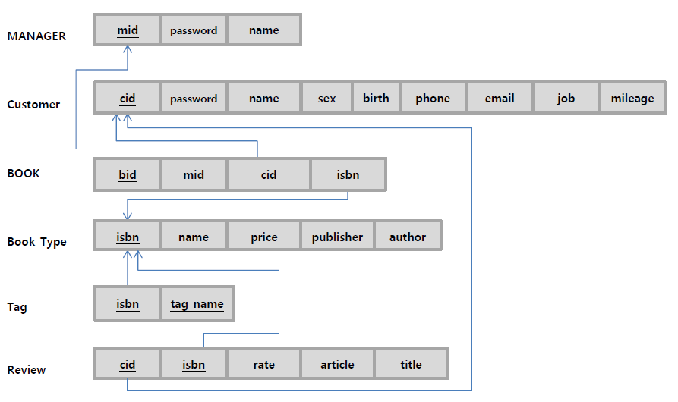
Relational Data Model :: Figure (Good Example)

Slide 8
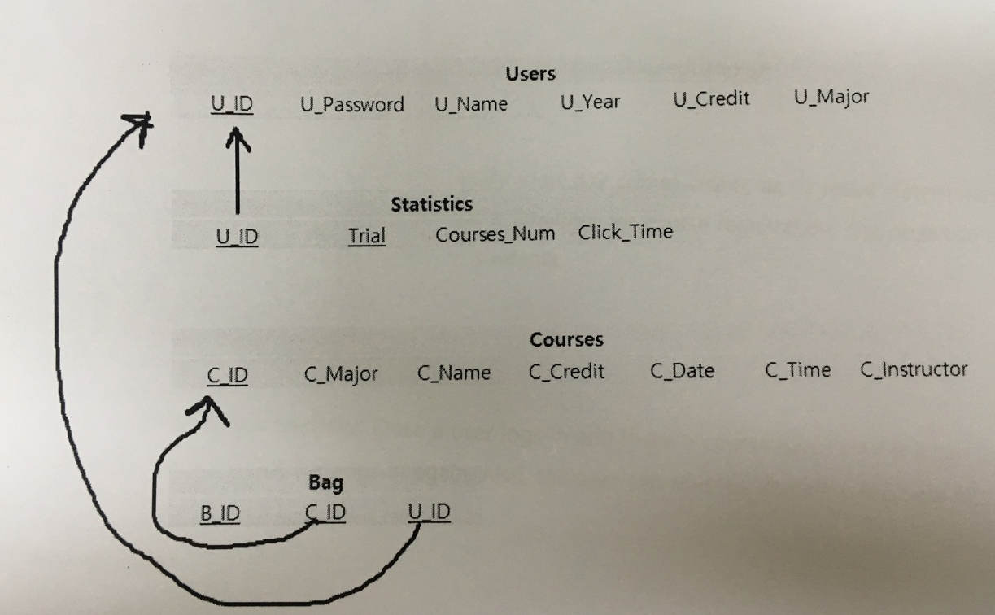
Relational Data Model :: Figure (Bad Example)
You need to create at least 5 tables

Slide 9
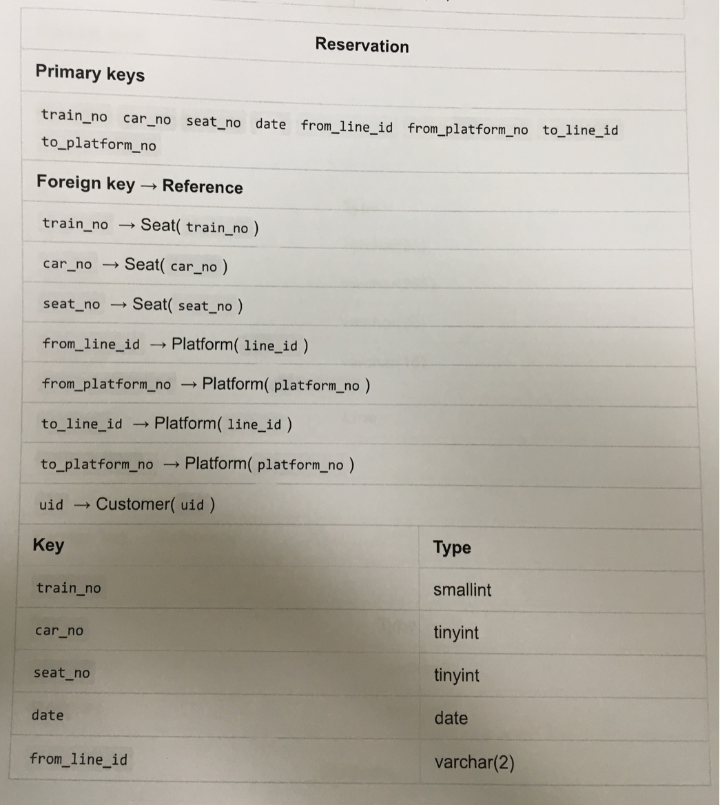
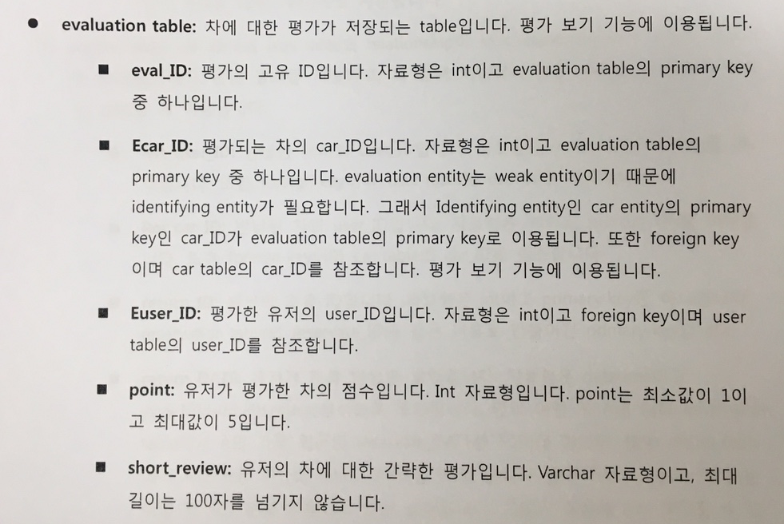
Relational Data Model :: Descriptions (Good Example)

Slide 10
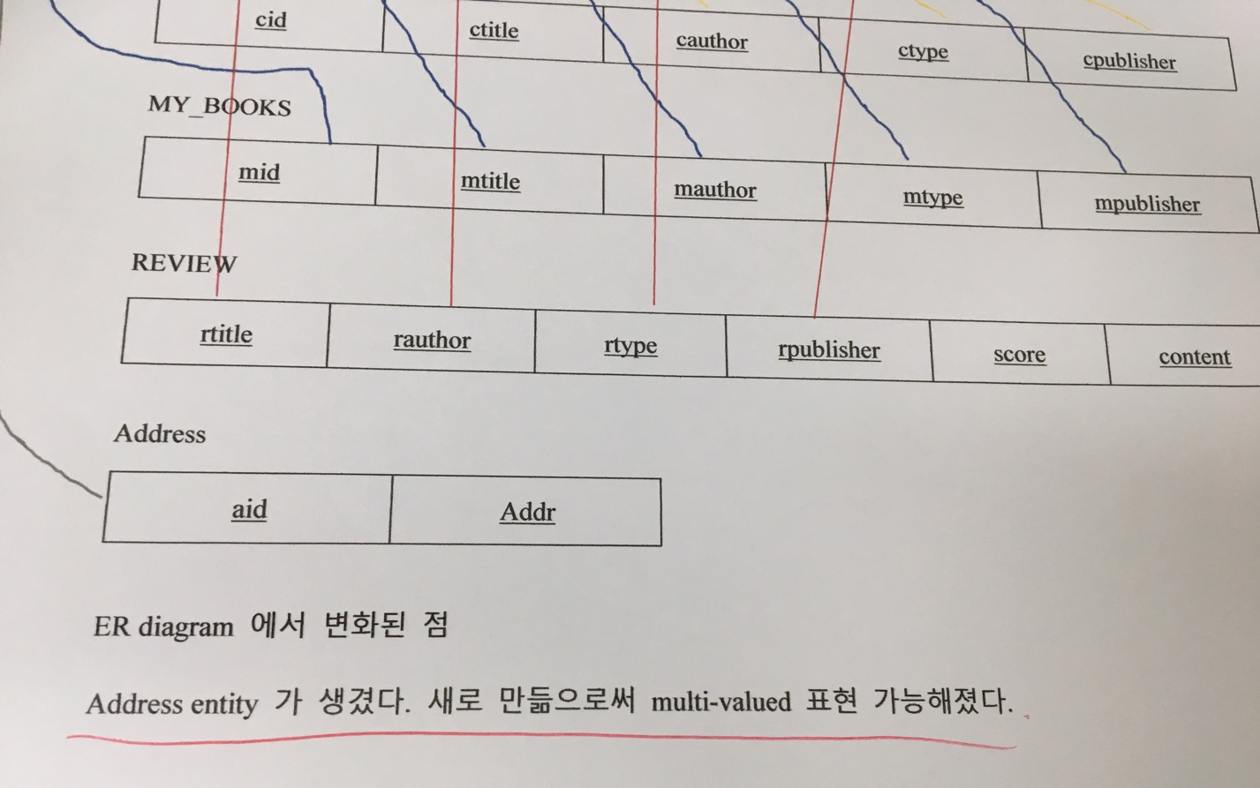
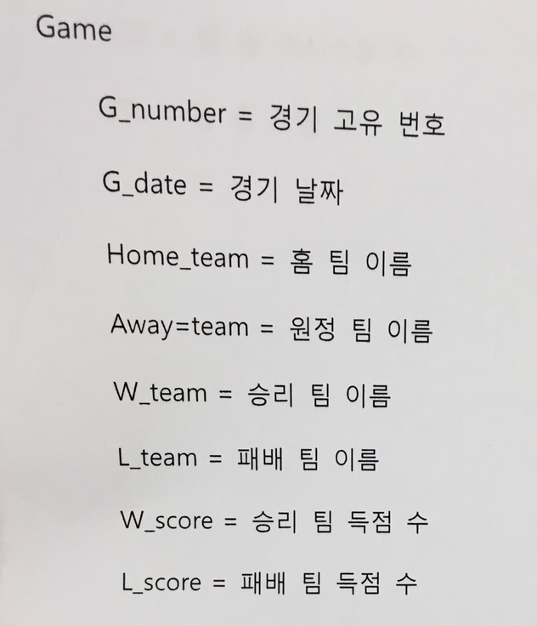
Relational Data Model :: Descriptions (Bad Example)
This is just a translation,
not an explanation
2 lines are not enough for explanation

Slide 11
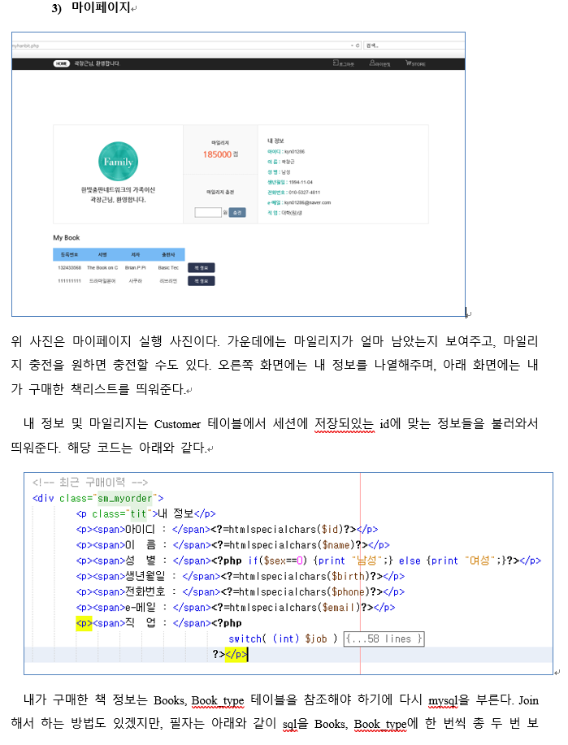
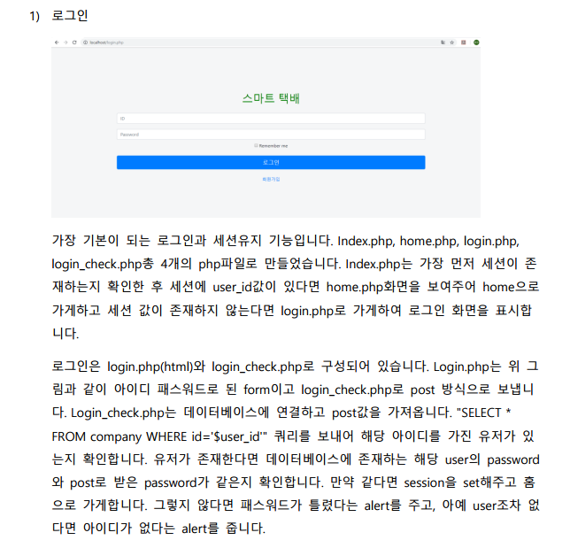
Implementation and Results :: Descriptions (Good Example)

Slide 12
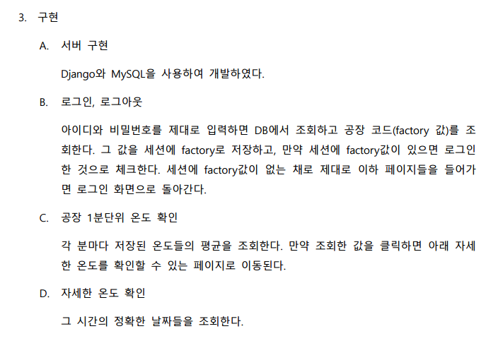
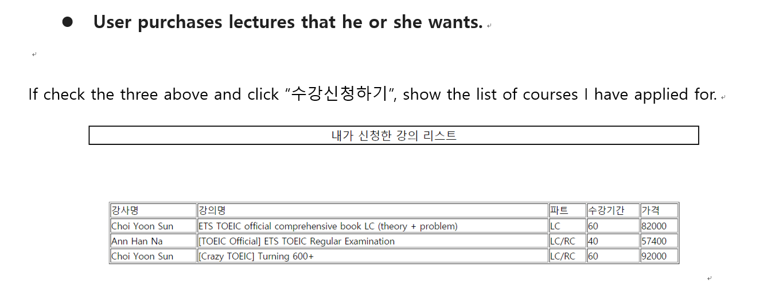
Implementation and Results :: Descriptions (Bad Example)
No screenshot
No explanation for implementation
Not enough explanation for implementation

